Slide 1
Hyperparameter Tuning and Evaluation

Slide 2
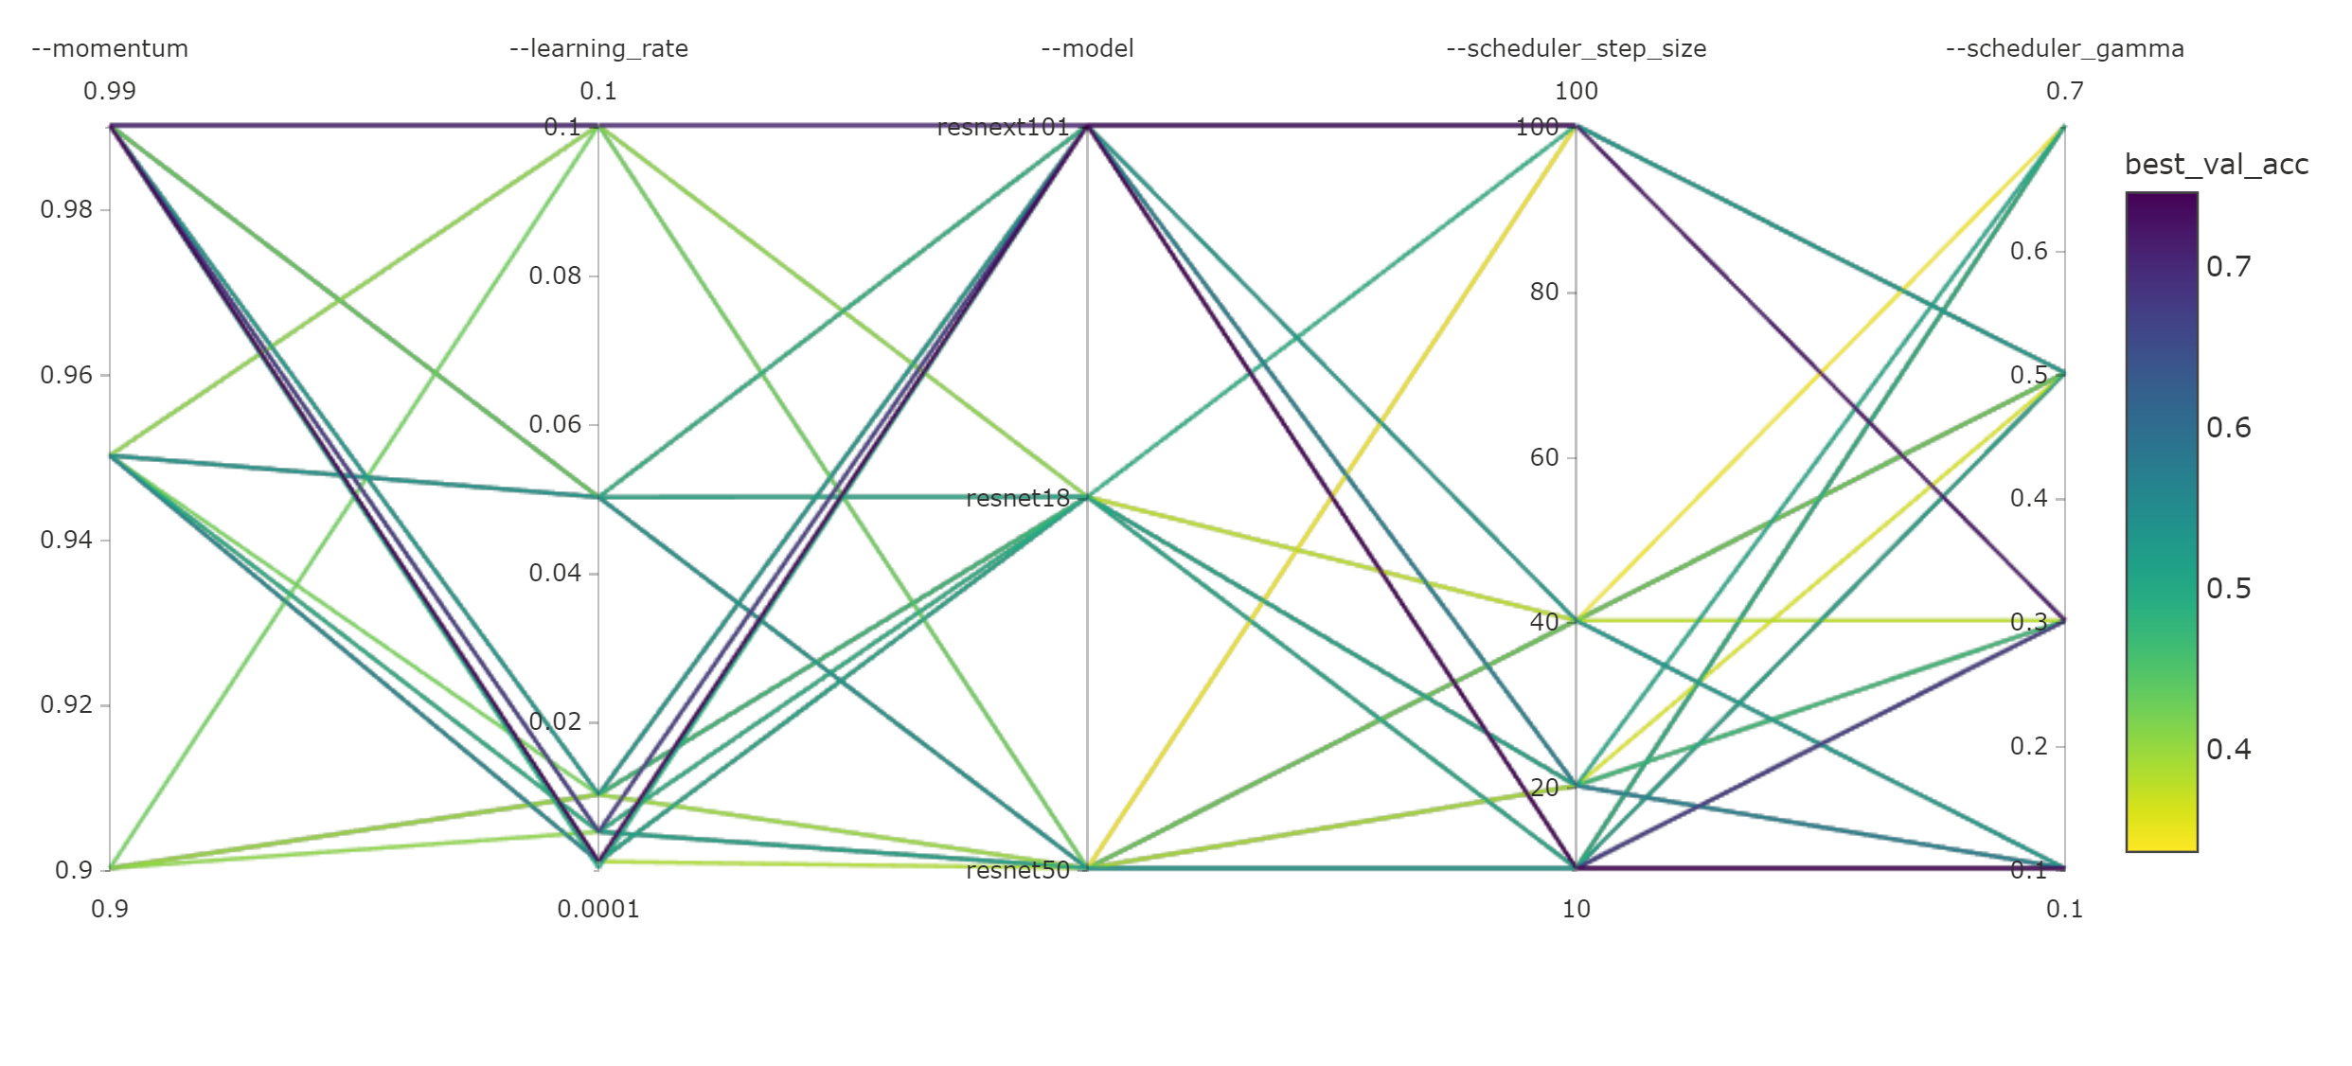
Hyperparameters
Adjustable parameters chosen prior to training a model
e.g., learning rate, momentum, batch size, number/size of hidden layers, number of pooling layers, weight decay, learning rate decay, dropout ratio, …
ML/DL model accuracy depends heavily on hyperparameter selection

Slide 3
AzureML.Train.HyperDrive
Hyperparameter exploration tool
Automate the exploration process
Achieve desired model accuracy
Minimize training time and resources
Apply to different models and learning domains
HyperDrive is an automated hyperparameter tuning tool that helps users find better results in a cost-effective manner.

Slide 4

How HyperDrive Works
Input
Launch multiple parallel training runs
Output
0.79
Run 6
Run 5
Training data
0.81
0.97
Run 2
Training script
Run p
Hyperparameter 2
0.88
0.77
Run 7
Hyperparameter config with best metric
Run 3
Define goals
0.35
0.75
Apply constraints
Run 1
Hyperparameter 1
© Microsoft Corporation Azure

Slide 5






HyperDrive - Hyperparameter Tuning Capabilities
1.
2.
3.
4.
5.
6.
Automated Exploration
Reduced Training Time
Efficient Resource Usage
User Controls
Deep Learning / Traditional ML, Framework Agnostic
Easily find best performing config
Automates the process of exploring the hyperparameter space, saving data scientists significant time and effort
Find better models faster using parallel job orchestration and intelligent early termination
Intelligently early terminates poor performing configurations to save compute costs
Users can specify a primary metric to optimize and a maximum budget in terms of number of jobs or duration. Choose from Random, Bayesian & Grid sampling
Applies to different models and learning domains. Use with Tensorflow, PyTorch, Scikit Learn or any other training framework of your choice
Visualize all configs together and easily identify hyperparameter values that result in optimal performance. Deploy model from this best config and infer using AML

Slide 6
What hyperdrive offers
Intelligent Hyperparameter generation, with support for following sampling methods
Random
Grid
Bayesian
Intelligent early termination to terminate non-performing jobs early. Early termination policies supported being
Bandit
Median Stopping
TruncationSelection
Parallel Job orchestration
Visualize all configurations in one place
Ability to warm restart a run.
Ability to resume an existing experiment
Ability to resume previously cancelled runs

Slide 7
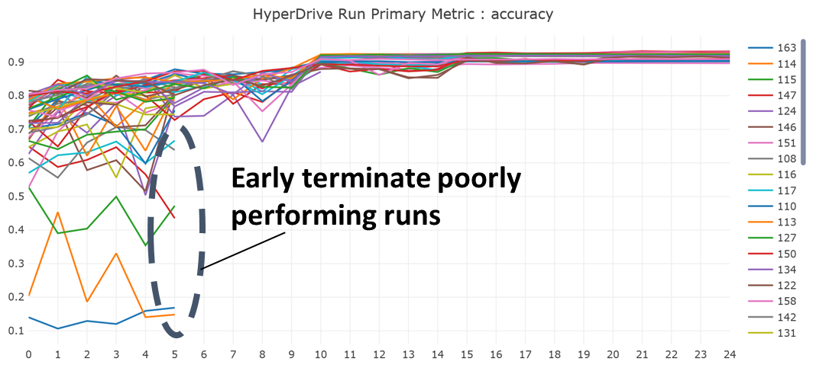
Manage Active Jobs
Supported early termination algorithms
Bandit policy​
Median Stopping policy​
Truncation Selection policy

Slide 8
User inputs & system outputs
Hyperparameter Tuning Config –
Hyperparameter ranges
Optimization metric
Early Termination Policy
Budget – Time / Compute
# parallel runs
Training script
+
Training data
Recommended hyperparameter configuration & run metrics
Hyperparameter Tuning in Azure ML

Slide 9
Tune Hyperparameters using Hyperdrive
Steps for creating an experiment:
Create a script that can take hyperparameters as inputs
Identify hyperparameters search space.
Pick a sampling method, and use hyperparameter space with sampling method
Choose a primary metric to optimize on and log that primary metric
Pick early termination policy (Default is no Early termination)
Allocate resources (total duration, concurrency)
Create Hyperparameter tuning Configuration for experiment.
Submit the experiment.

Slide 10
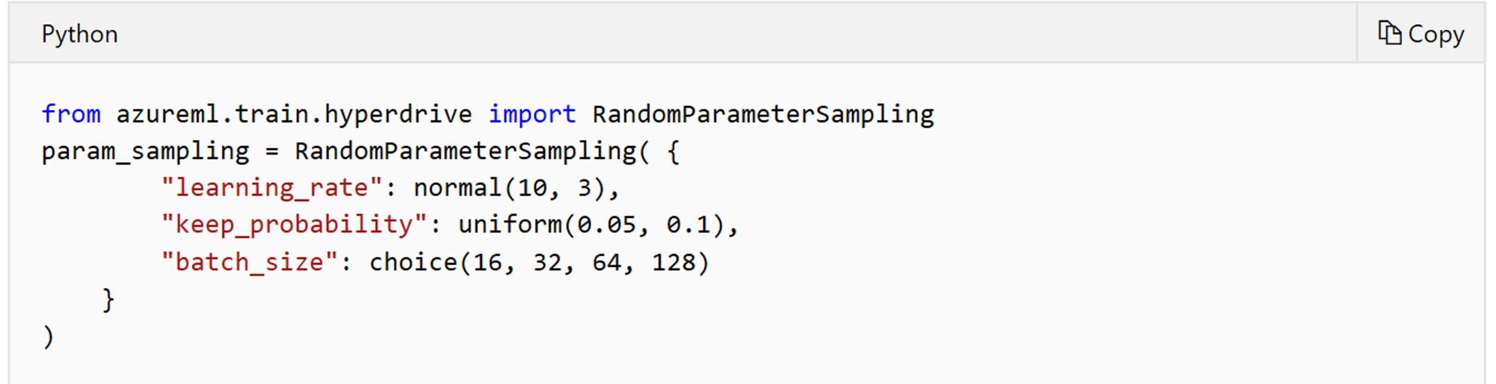
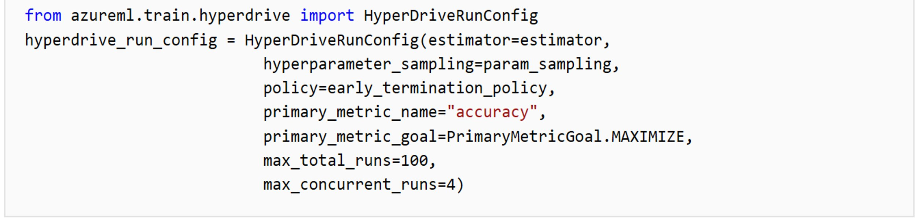
Configuring a HyperDrive experiment

Slide 11
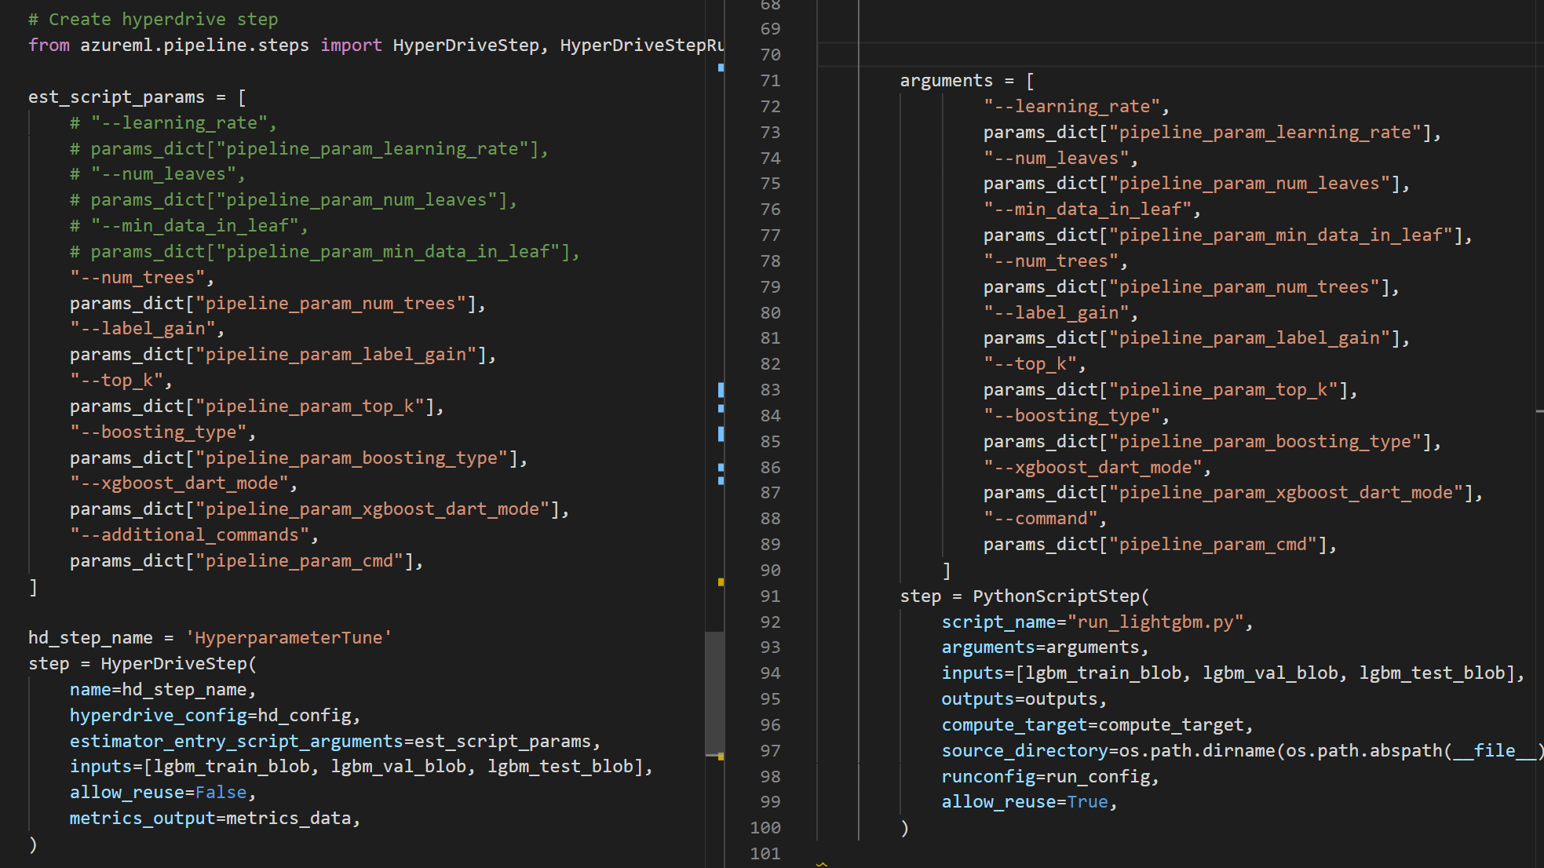
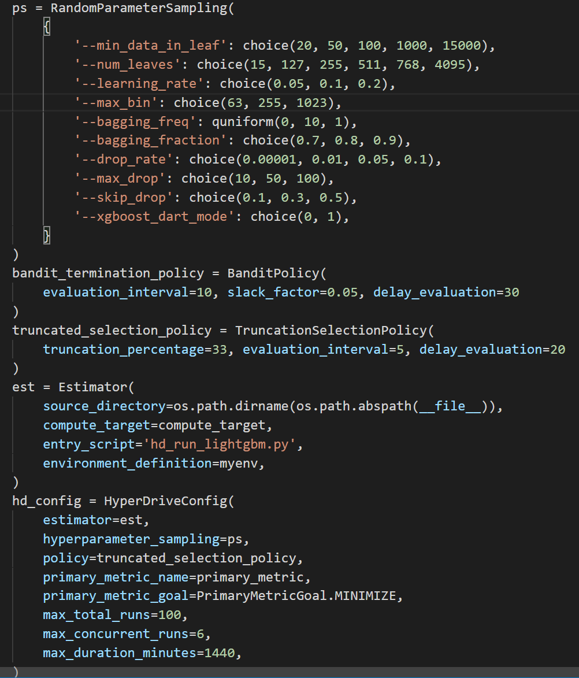
Single parameter set vs
Hyperdrive Hyper Parameter Tuning
(1)
(2,3)
(5)
(7)
(4)
(6)
Steps for creating a Hyperdrive experiment:
Create a script that can take hyperparameters as inputs
Identify hyperparameters search space.
Pick a sampling method, and use hyperparameter space with sampling method
Choose a primary metric to optimize on and log that primary metric
Pick early termination policy (Default is no Early termination)
Allocate resources (total duration, concurrency)
Create Hyperparameter tuning Configuration for experiment.
Submit the experiment.

Slide 12
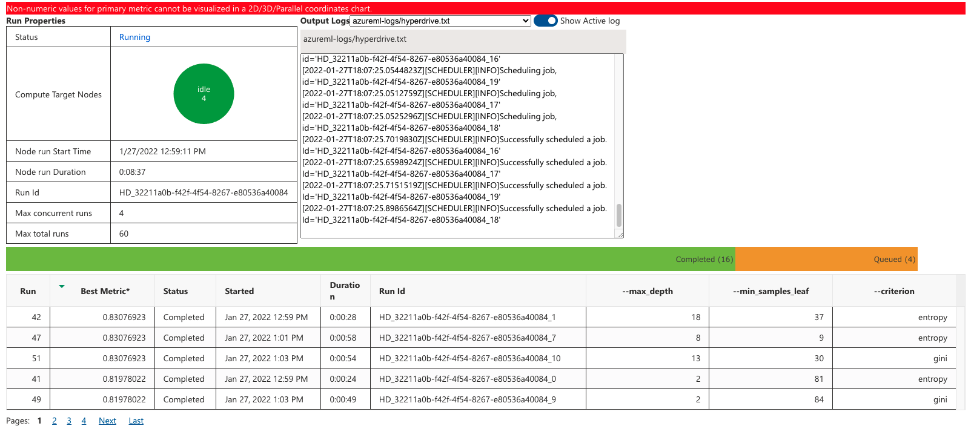
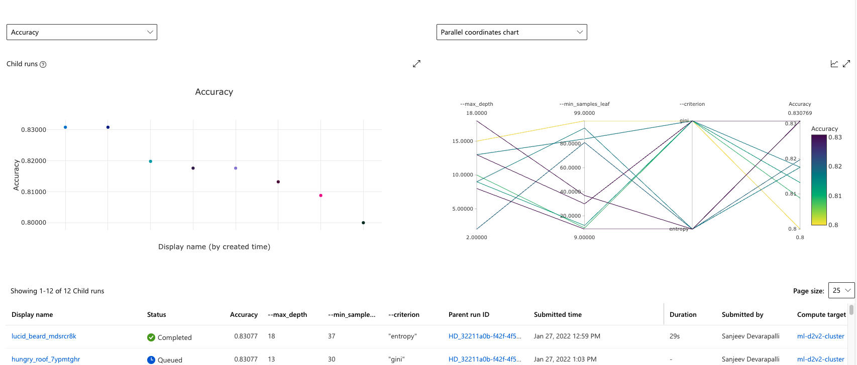

Demo
For more information on how to use HyperDrive:
Hyperparameter Tuning Docs
Hyperparameter Tuning Notebook Samples
Challenge
Please find the “song-classification-challenge.ipynb” Challenge notebook for this module here

